Slide 1
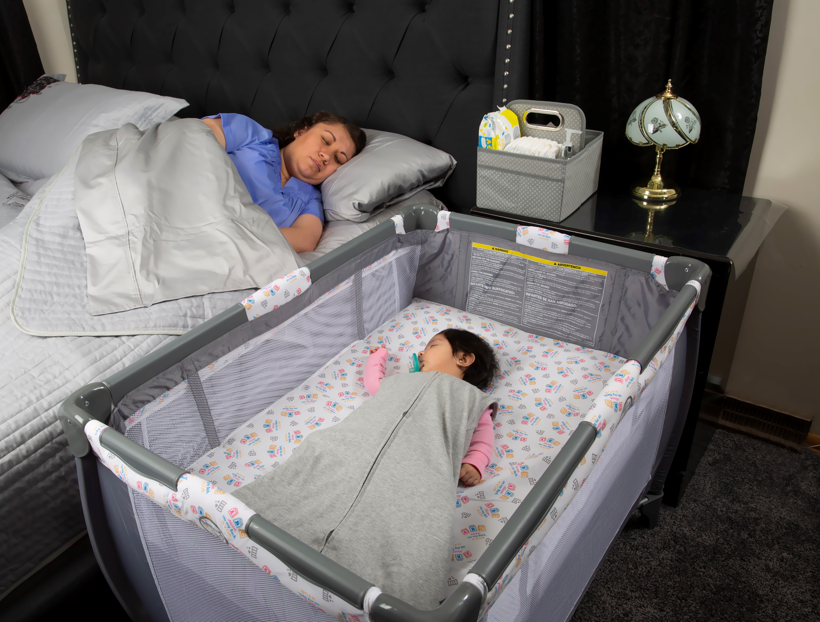
Wrestling with Safe Sleep
Christy Schunn, LSCSW
Executive Director
Notes:
Introduce yourself, agency
This presentation, Wrestling with Safe Sleep, is part of the Kansas Infant Death and SIDS Network Safe Sleep Certification Project aimed specifically at reducing sleep-related deaths.
Provide Pretest and collect before presentation
Do you have initial questions/concerns before we begin?

Slide 2
Presentation Options
You may choose to host trainings:
In-person while abiding by social distancing guidelines
Video Conference (Zoom, Microsoft Teams, Skype, Webex)
Webinar (GoToMeeting, Webex)
Links are available for participants to complete electronically via Redcap

Slide 3
Pre-Test

Slide 4
Sleep-Related Infant Death
Sudden, Unexpected Infant Death (SUID)
Manner and cause of death are not immediately obvious prior to investigation
Accidental suffocation or asphyxiation while sleeping
Sudden Infant Death Syndrome (SIDS)
When an infant seems to be healthy, but dies usually while sleeping, for no other reason
Sometimes called “crib death”
Unknown
Notes:
The purpose of today’s presentation is to reduce sleep related deaths. To do so, we must first define what constitutes a sleep related death.
SUID (Sudden Unexpected Infant Death) is a death of an infant less than 1 year of age that occurs suddenly and unexpectedly. After a full investigation, these deaths may be diagnosed as suffocation, asphyxia, entrapment, infection, ingestions, metabolic diseases, cardiac arrhythmias, trauma, either accidental or non-accidental, or SIDS.
Accidental suffocation or strangulation in bed (ASSB) is a classification used when the terms such as asphyxia, suffocation or strangulation are reported, along with the terms bed or crib in the investigation report.
In some cases, where the evidence is not clear or not enough information is available, the death is considered of undetermined cause or unknown.

Slide 5
What is SIDS?
Sudden Infant Death Syndrome (SIDS) is “the sudden death of an infant under one year of age which remains unexplained after a thorough case investigation, including”:
Performance of a complete autopsy,
Examination of the death scene, and
Review of the clinical history.”
Notes:
Drill down
Read from the slide…SIDS diagnosis is only made for infants who die suddenly under the age of one year which remains unexplained after an autopsy, death scene investigation and review of clinical history, like the medical record.

Slide 6
Infant Mortality Data Kansas in 2018
36,268 Babies born
231 died before their 1st birthday
Source: KDHE, Annual Summary of Vital Statistics for 2018
Notes:
To give you some perspective, in 2018, 231 Kansas infants died before their first birthday. That is 6.4 deaths per 1,000 live births. The national goal set by Healthy People 2020 is an infant mortality rate below 6.0. 2015 was the first year that Kansas had ever been below the 6.0 goal.

Slide 7
Kansas Infant Mortality 2014-2018
Source: Bureau of Epidemiology and Public Health Informatics, KDHE
Notes:
To learn more about the issues related to infant mortality we must look at 5 year rolling averages. From 2014-2018, the KDHE reports:
The leading cause of infant death is congenital anomalies (neural tube defects like spina bifida and anencephaly)
2nd leading cause is Sudden Unexpected Infant Death (SIDS, ASSB, undetermined or what many consider to be sleep-related deaths)
3rd leading cause is prematurity or low birth weight
Other causes include: rare diseases like necrotizing enterocolitis (NEC), car accidents are other external causes, etc.

Slide 8
Infant Mortality Data 2018 State Child Death Review
Sleep-Related Deaths = 43 (22 of 43 were in an adult bed)
Characteristics of Sleep-Related Infant Deaths in Kansas
51% were sleeping in an adult bed (40% were co-bedding).
86% were not sleeping in a safety approved crib/bassinet.
26% were sleeping on a couch, while co-bedding.
9% were sleeping in infant swing/nursing pillow/air mattress/trundle beds/etc.
Characteristics of SIDS Deaths in Kansas
31% were documented as not being placed on the back to sleep (recommended position)
100% had one or more elements of unsafe sleep
85% were less than 5 months old
Breastfeeding Numbers:
23% (10 of the 43) of sleep-related infant deaths, the mother/caregiver reportedly fell asleep while breast (7) or bottle (3) feeding the infant.
Source: 2020 Kansas State Child Death Review Board
Notes:
The State Child Death Review Board examines trends and patterns that identify risk factors in the deaths of children, from birth through 17 years of age.
The State Child Death Review Board has developed the following three goals to direct its work:
1. To describe trends and patterns of child deaths, identifying risk factors in the population;
2. To improve inter-agency communication so recommendations can be made regarding recording of actual cause of death, investigation of suspicious deaths, and system responses to child deaths;
3. To develop prevention strategies including community education and mobilization, professional training, and changes in legislation, public policy and/or agency practices.
It should be noted that the numbers and rates in SCDRB annual report should not be expected to be the same as those reported in the KDHE Annual Summary of Vital Statistics, which monitors deaths of Kansas residents only. After review by the board, the classification of the cause or manner of death may be different from the coroner’s. For example, an infant death suspicious for asphyxia may be called an undetermined death by the coroner, but after the board reviews medical, law enforcement, and other pertinent reports, additional information may support the board’s classification of the death as Sudden Infant Death Syndrome, Category II.
According to the 2017, KSCDRB Annual Report there were 41 sleep related deaths, of which 27 were found unresponsive in an adult bed. Thus,
66% were sleeping an adult bed (51% were co-bedding)
83% were not sleeping in a safety approved crib/bassinet
7% were sleeping on a chair, floor, swing, boppy, etc.
7% were sleeping on a couch, while co-bedding
89% of SIDS deaths had one or more elements of unsafe sleep
It is important to differentiate between co-bedding in an adult bed and sofa/couch. Some bed-sharing proponents argue the “don’t sleep with infants” leads parents to co-sleep on couches/sofa; thus, increasing deaths on couches and sofas. The KS Child Death Review Board data clearly reports the majority (66%) of sleep-related deaths occur in the adult bed.

Slide 9
Strategy: Consistent Safe Sleep Messages
Preconception
Family
Friends
Community
Health education
Prenatal
Clinical Care
Prenatal education
Home visitation
Birth
Hospital
Birthing centers
Well-child and acute visits
Maternal post-partum visit
Child care
Home visitation
Hospital readmit
First year
Notes:
The KIDS Network strategy to reduce sleep-related deaths is to provide consistent safe sleep messages along a continuum of care. We strive to educate new and expectant parents, caregivers, grandparents, and anyone caring for an infant in the first year of the infant’s life. Consistent messaging must be provided in the community, clinics, hospitals, birthing centers and child care facilities

Slide 10
Reducing Infant Mortality
Parents/caregivers are most likely to follow the safe sleep guidelines if they:
Received information from healthcare providers
Received consistent messages from multiple healthcare providers
Received consistent messages from trusted female friends and relatives
Observed healthcare providers following the recommended behaviors
Notes:
What we know is that parents and caregivers are most likely to follow safe sleep guidelines when a healthcare provider promotes safe sleep practices. It is also important that the healthcare providers deliver consistent messages. We also know new parents turn to trusted female friends and relatives. The more people sharing information about safe sleep practices, the more likely families will follow them. And lastly, it is important that providers and educators model safe sleep behaviors.

Slide 11
Source: Bureau of Epidemiology and Public Health Informatics, KDHE
Notes:
There is an obvious racial disparity between Non-Hispanic White people and people of color. Non-Hispanic Black babies are almost three times more likely to die in infancy and Native American babies are over 2 times more likely to die of SIDS, than their Non-Hispanic White counterparts. Infant mortality is a complex issue and social determinants like poverty, education and chronic stress may influence these rates.
This chart describes the leading causes of death by population group. Thus, SUID is the second leading cause of death for Non-Hispanic Black and Non-Hispanic White infants, but 3rd in the Hispanic population.
Nationally, Hispanic SUIDS deaths have historically been lower than Non-Hispanic White SUIDS deaths. However here in Kansas, an upward trend in Hispanic infant mortality has been noted.

Slide 12
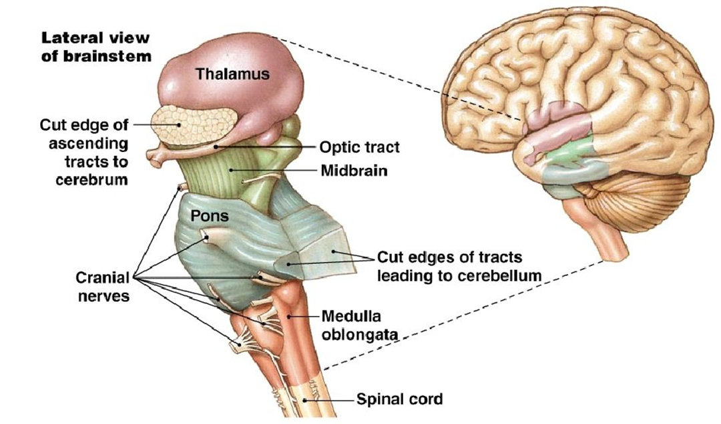
Research Triple Risk SIDS Theory
Physiological Response
Development
External Stress Factors
Infant Physiologic Responses
Arousal response deficit
Subtle brainstem dysfunction
Slow development
External Stress Factors
Sleep position
Bedding
Temperature
Season
Swaddling
Poverty
Limited prenatal care
Smoking
Drug use
Minor respiratory symptoms
SIDS
Development
(autonomic nervous system)
2-4 months – most unstable
4-6 months – decreasing instability
Hannah C. Kinney, Harvard Medical School, Boston
Notes:
Simple Sentence: True SIDS occurs about 1 time a year in Kansas, the remaining sleep-related deaths are thought to be due to Accidental Suffocation and Strangulation in Bed (ASSB). It is believed that true SIDS occurs when the infant has an unknown brainstem abnormality, is developmentally vulnerable and is exposed to environmental stressors. However, the strategies to reduce the risk of SIDS and all sleep-related deaths are the same. (Stop here based on your audience).
For more advanced learners: The brainstem abnormality appears to fit into the triple-risk model of SIDS, which holds that SIDS occurs only when three elements come together. This theory, developed by Dr. Hannah Kinney at Harvard Medical School, is referred to as the Triple-Risk Theory. The theory includes three components: 1) an infant who has a subtle brainstem dysfunction, 2) an unstable autonomic nervous system which is common between two and six months of age and 3) an external stress factor such as prone sleeping, overheating, or exposure to smoke.
This subtle infant physiologic response deficit is like the brain has a malformation or was slow to develop for some unknown reason. This part of the brain has a mechanism that I think of like smoke detector. When a room fills with smoke, a working smoke detector alarms you. However, if the smoke detector is broken you might sleep through the fire. Thus, if the baby has a broken mechanism in the base of the brain or a broken alarm system, so to speak, the baby is not alarmed and dies rather than crying, startling, or lifting her head.
In the triple risk model, SIDS occurs only if all three conditions come together on the wrong night or day; a vulnerable infant during that peak developmental stage is exposed to an environmental factor that he, because of his particular vulnerability, is unable to recover from. We can not identify those infants with brainstem abnormalities, nor can we prevent normal development, however we can intervene by reducing external stress factors.

Slide 13
Research AAP guidelines
Source: aap.org
Notes:
The American Academy of Pediatrics has published infant safe sleep recommendations to reduce external risk factors. The most recent guidelines were published in October 2016. The remainder of the presentation will address the AAP’s risk reduction strategies.

Slide 14
Safe Sleep Position
Healthy term infants should be placed on their back to sleep for every sleep.
Notes:
To reduce the risk of SIDS, infants should be placed for sleep in a supine position, wholly on the back, for every sleep by every caregiver until the child reaches 1 year of age. Side sleeping is not safe and is not advised.
Although data to make specific recommendations as to when it is safe for infants to sleep in the prone or side position are lacking, studies establishing prone and side sleeping as risk factors for SIDS include infants up to 1 year of age. Therefore, the best evidence suggests that infants should continue to be placed supine until 1 year of age. Once an infant can roll from supine to prone and from prone to supine, the infant can be allowed to remain in the sleep position that he or she assumes. Because rolling into soft bedding is an important risk factor for SUID all the way to 1 year of age. Parents and caregivers should continue to keep the infant’s sleep environment clear of soft or loose bedding.
(Recommendation #1)

Slide 15
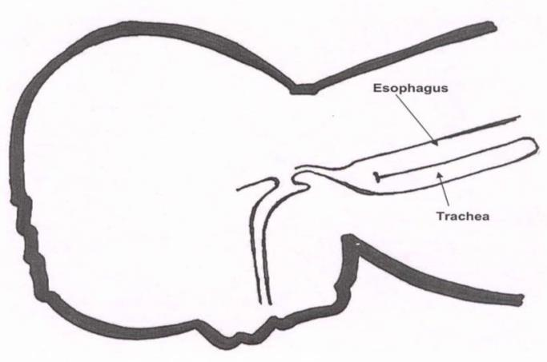
Safe Sleep Position
Prone – “tummy”
Supine – “back”
Notes:
The supine sleep position does not increase the risk of choking and aspiration in infants, even those with gastroesophageal reflux, because infants have airway anatomy and mechanisms that protect against aspiration. As this slide shows, babies are less likely to choke when placed supine. When babies are in the back sleep position, the trachea, or windpipe, lies on top of the esophagus, the food tube. Anything regurgitated or refluxed from the esophagus must work against gravity to be aspirated into the trachea.
If medical personnel determine that the stomach sleep position is necessary because of a medical condition or other concern, health care providers should advise parents and caregivers to reduce the risk of SIDS in other ways, such as by avoiding soft bedding and ensuring that infants do not overheat during sleep. For most infants, however, stomach and side sleeping are not advised.
Elevating the head of the infant’s crib is ineffective in reducing gastroesophageal reflux and is not recommended; in addition, elevating the head of the crib may result in the infant sliding to the foot of the crib into a position that may compromise respiration.

Slide 16
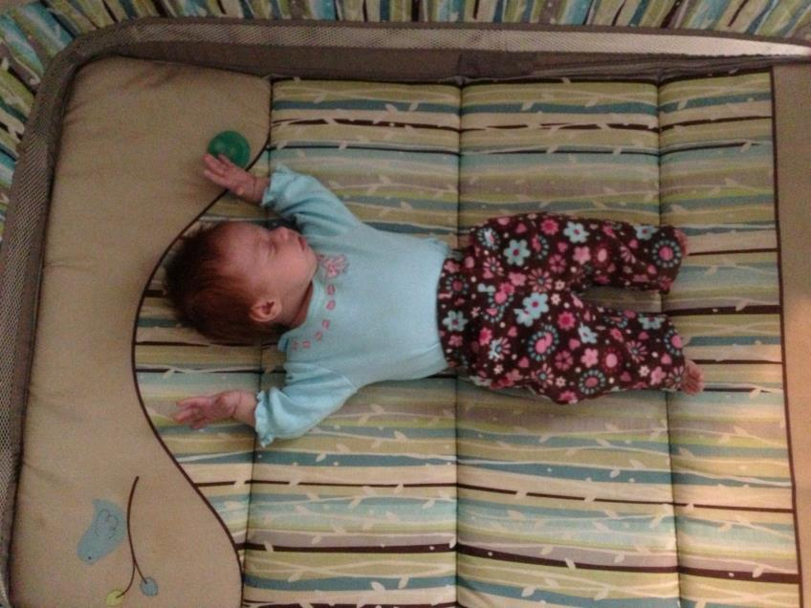
Safe Sleep Environment
Place the baby on a firm sleep surface in safety approved crib
The sleep surface should be bare
One infant per crib
Notes:
Infants should be placed on a firm sleep surface for example a mattress in a safety-approved crib/bassinet/portable crib, covered by a fitted sheet, if necessary, with no other bedding or soft objects to reduce the risk of SIDS and suffocation.
A firm surface maintains its shape and will not indent or conform to the shape of the infant’s head when the infant is placed on the surface. Soft mattresses, including those made from memory foam, could create a pocket (or indentation) and increase the chance of rebreathing or suffocation if the infant is placed in or rolls over to the prone position.
(Safe Sleep Recommendation #2)
The safety and benefits of cobedding for twins and higherorder multiples have not been established. It is prudent to provide separate sleep surfaces and avoid cobedding for twins and higherorder multiples in the hospital and at home.
(Safe Sleep Recommendation #4)

Slide 17
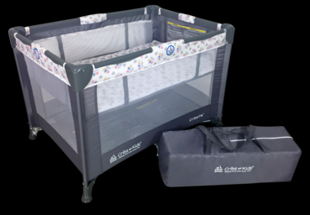
Cribs for Kids
Notes:
A suggested alternative to a full-size crib is a safety approved portable crib as shown here.
A crib, bassinet, portable crib, or play yard that conforms to the safety standards of the Consumer Product Safety Commission (CPSC), including those for slat spacing less than 2-3/8 inches, snugly fitting and firm mattresses, and no drop sides, is recommended. In addition, parents and providers should check to make sure that the product has not been recalled. This is particularly important for used cribs. Cribs with missing hardware should not be used, nor should the parent or provider attempt to fix broken components of a crib, because many deaths are associated with cribs that are broken or with missing parts (including those that have presumably been fixed). Local organizations throughout the United States can help to provide low-cost or free cribs or play yards for families with financial constraints.
(Safe Sleep Recommendation #2)

Slide 18
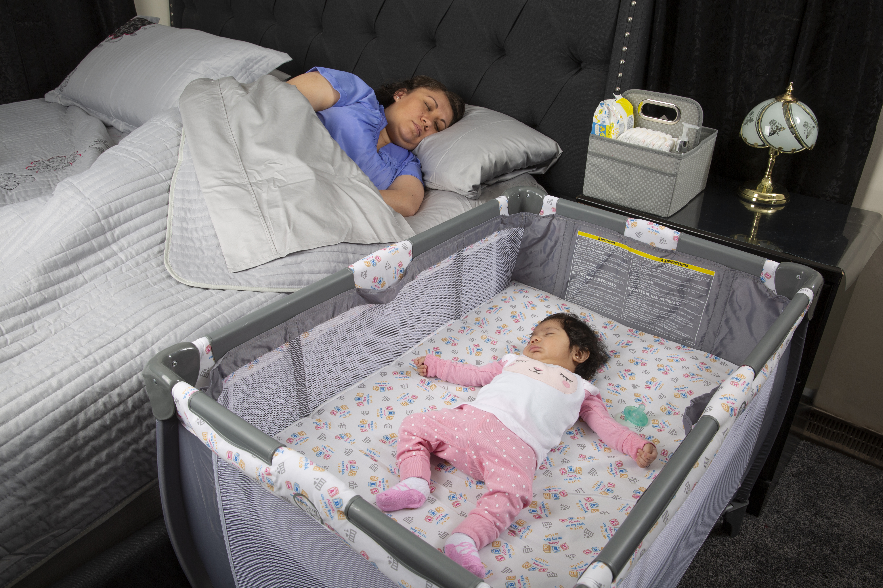
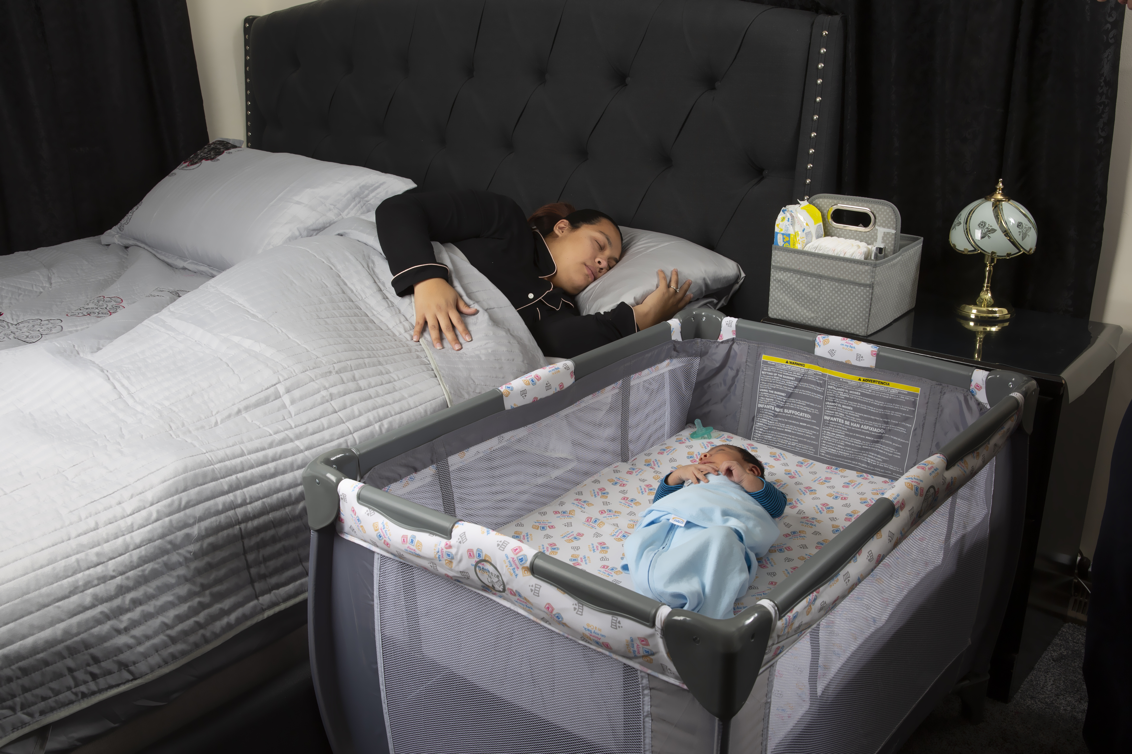
Same Room Separate Bed
Notes:
Like these photos depict room sharing without bedsharing is the safest sleep environment. Bedside sleepers are attached to the side of the parental bed. The CPSC has published safety standards for these products, and they may be considered by some parents as an option. However, there are no CPSC safety standards for in-bed sleepers. The task force cannot make a recommendation for or against the use of either bedside sleepers or in-bed sleepers, because there have been no studies examining the association between these products and SIDS or unintentional injury and death, including suffocation.
Infants should not be placed for sleep on beds, because of the risk of entrapment and suffocation.
(Recommendation #2)

Slide 19
Unsafe Sleep Environment
Notes:
This photo is from a magazine spread displaying Jennifer Lopez’ nursery for her twins.
How many unsafe sleep items do you see in this picture: Stuffed animals, Bumpers, Fluffy blankets?
Soft materials or objects, such as pillows, quilts, comforters, or sheepskins, even if covered by a sheet, should not be placed under a sleeping infant.
In addition, portable bed rails should not be used with infants, because of the risk of entrapment and strangulation.
The infant should sleep in an area free of hazards, such as dangling cords, electric wires, and window-covering cords, because these may present a strangulation risk.
(Safe Sleep Recommendation #2)

Slide 20
Unsafe Sleep Environments
Sitting devices including:
Car seats
Strollers
Swings
Infant Carriers
Infant Slings
Rock ‘n Play
Sling
Swing
Carrier
Rock ‘n Play
Notes:
Sitting devices, such as car seats, strollers, swings, infant carriers, and infant slings, are not recommended for routine sleep in the hospital or at home, particularly for young infants. Infants who are younger than 4 months are particularly at risk, because they may assume positions that can create a risk of suffocation or airway obstruction or may not be able to move out of a potentially asphyxiating situation.
When infant slings and cloth carriers are used for carrying, it is important to ensure that the infant’s head is up and above the fabric, the face is visible, and the nose and mouth are clear of obstructions. After nursing, the infant should be repositioned in the sling so that the head is up, is clear of fabric, and is not against the adult’s body or the sling.
If an infant falls asleep in a sitting device, he or she should be removed from the product and moved to a crib or other appropriate flat surface as soon as is safe and practical.
Car seats and similar products are not stable on a crib mattress or other elevated surfaces. Infants should not be left unattended in car seats and similar products, nor should they be placed or left in car seats and similar products with the straps unbuckled or partially buckled.
Car seat covers should only be used outdoors, as they increase the risk of overheating, as well as trap CO2 in the area the baby is breathing, increasing the risk of suffocation.
Fisher Price Rock n Play has been recalled by the Consumer Product Safety Commission as of April 2019 and should not be used.
(Recommendation #2)

Slide 21
Commercial Devices
Avoid the use of commercial devices that are inconsistent with safe sleep recommendations.
Positioner
Co-Sleeper
Heart Rate
Monitor
Notes:
Be particularly wary of devices that claim to reduce the risk of SIDS. Examples include, but are not limited to, wedges and positioners and other devices placed in the adult bed for the purpose of positioning or separating the infant from others in the bed. Crib mattresses also have been developed to improve the dispersion of carbon dioxide in the event that the infant ends up in the prone position during sleep. Although data do not support the claim of carbon dioxide dispersion unless there is an active dispersal component, there is no harm in using these mattresses if they meet standard safety requirements. However, there is no evidence that any of these devices reduce the risk of SIDS. Importantly, the use of products claiming to increase sleep safety does not diminish the importance of following recommended safe sleep practices. Information about a specific product can be found on the CPSC Web site (www.cpsc.gov).
(Safe Sleep Recommendation #12)

Slide 22
Baby Boxes
Notes:
Some people are promoting the idea of babies sleeping in cardboard boxes. Many parents assume that a product must be safe if it is allowed to be sold. But to date, none of the boxes meet Consumer Product Safety Commission standards, because no safety standards have been set.
National organizations, such as the American Academy of Pediatrics (AAP) and the National Institute of Child Health and Human Development, have raised concerns regarding infant sleep boxes:
Potential poor air flow.
May tip over if placed on an unstable surface.
Infant weight and age limits are higher than those for a safety-approved bassinet, yet boxes for sale have a smaller sleep surface.
Cardboard is flammable.
Structural damage due to moisture or wear and tear.
Access to baby by pets and animals.
Cardboard attracts rodents and roaches.

Slide 23
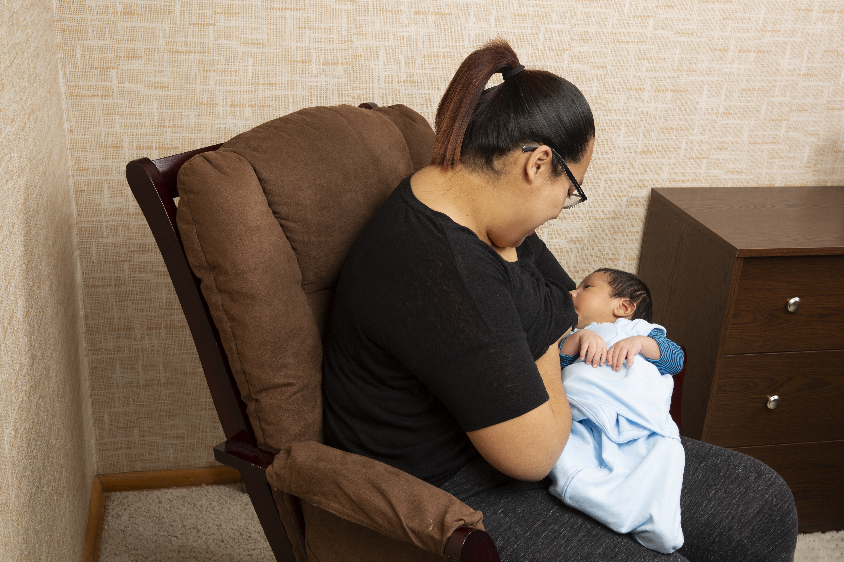
Safe Sleep and Breastfeeding
Breastfeeding is recommended and is associated with a reduced risk of SIDS
There is a 68% decreased risk of SIDS for infants who are exclusively breastfed.
There is a 32% decreased risk for SIDS for infants who are breastfed at all.
Notes:
Breastfeeding is recommended and is associated with a reduced risk of SIDS. Unless contraindicated, mothers should exclusively breastfeed or feed with expressed human milk, not offer any formula or other non–human milk– based supplements, for 6 months, in alignment with recommendations of the AAP.
The protective effect of breastfeeding increases with exclusivity. However, any breastfeeding has been shown to be more protective against SIDS than no breastfeeding.
(Safe Sleep Recommendation #3)

Slide 24
Tummy Time
Needed to develop strong muscles
For babies who are awake and being observed
Offered 2 to 3 times a day and increase the amount as the baby becomes stronger.
Notes:
Health care providers should advise parents and caregivers that a certain amount of Tummy Time is a very important and necessary part of an infant’s development. Infants need two or three sessions of supervised Tummy Time every day. Older babies need even more Tummy Time to help their bodies get ready to sit up, roll over, crawl, and walk. Tummy Time should begin as early as possible to promote motor development, facilitate development of the upper body muscles, and minimize the risk of positional plagiocephaly, or flat spots.
Tummy time needs to be done on a firm surface, like the floor; the resistance will help build the muscles in the neck and shoulders.
(Safe Sleep Recommendation #14)

Slide 25
Pacifier Use
Consider offering a pacifier at nap time and bed-time.
Notes:
Although the mechanism is yet unclear, studies have reported a protective effect of pacifiers on the incidence of SIDS. The protective effect of the pacifier is observed even if the pacifier falls out of the infant’s mouth.
The pacifier should be used when placing the infant for sleep. It does not need to be reinserted once the infant falls asleep. If the infant refuses the pacifier, he or she should not be forced to take it. In those cases, parents can try to offer the pacifier again when the infant is a little older.
Because of the risk of strangulation, pacifiers should not be hung around the infant’s neck. Pacifiers that attach to infant clothing should not be used with sleeping infants. Objects, such as stuffed toys and other items that may present a suffocation or choking risk, should not be attached to pacifiers.
For breastfed infants, pacifier introduction should be delayed until breastfeeding is firmly established. Infants who are not being directly breastfed can begin pacifier use as soon as desired.
(Recommendation #6)

Slide 26
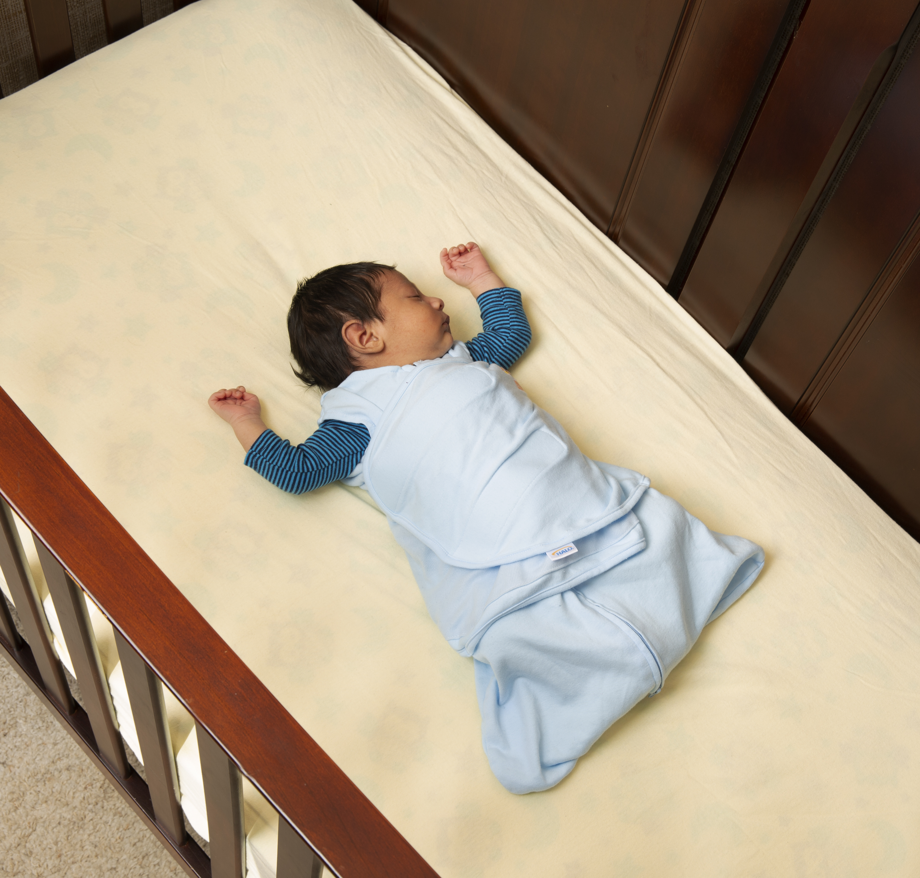
Maintaining Temperature
Make sure the baby's head remains uncovered during sleep
Consider using a wearable sleeper or other sleep clothing as an alternative to blankets.
Dress the baby in light sleep clothing
Notes:
Infant sleep clothing, such as a wearable blanket, is preferable to blankets and other coverings to keep the infant warm while reducing the chance of head covering or entrapment that could result from blanket use.
In general, infants should be dressed appropriately for the environment, with no greater than 1 layer more than an adult would wear to be comfortable in that environment.
Parents and caregivers should evaluate the infant for signs of overheating, such as sweating or the infant’s chest feeling hot to the touch. Overbundling and covering of the face and head should be avoided.
There is currently insufficient evidence to recommend the use of a fan as a SIDS risk-reduction strategy.
(Safe Sleep Recommendation #9)

Slide 27
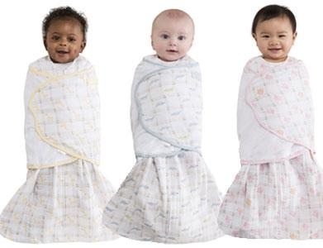
Swaddling
Swaddle a baby who wants to be swaddled
Not too hot
Not too tight
Not able to flip over
Notes:
Swaddling, or wrapping the infant in a light blanket, is often used as a strategy to calm the infant and encourage the use of the supine position. There is a high risk of death if a swaddled infant is
placed in or rolls to the prone position. If infants are swaddled, they should always be placed on the back.
Swaddling should be snug around the chest but allow for ample room at the hips and knees to avoid exacerbation of hip dysplasia. When an infant exhibits signs of attempting to roll, swaddling should no longer be used. There is no evidence with regard to SIDS risk related to the arms swaddled in or out.
These decisions about swaddling should be made on an individual basis, depending on the physiologic needs of the infant. Health care professionals, staff in newborn nurseries and NICUs, and child care providers should endorse and model the SIDS risk reduction recommendations from birth.
(Safe Sleep Recommendation #15)

Slide 28
Avoid Smoke Exposure
Go outside to smoke
Wear an overcoat
Removed the overcoat upon return
Exposure to smoke in a room where babies sleep, is linked to an increased risk of SIDS.
Notes:
Both maternal smoking during pregnancy and smoke in the infant’s environment after birth are major risk factors for SIDS.
Mothers should not smoke during pregnancy or after the infant’s birth. There should be no smoking near pregnant women or infants. Encourage families to set strict rules for smoke-free homes and cars and to eliminate secondhand tobacco smoke from all places in which children and other nonsmokers spend time.
The risk of SIDS is particularly high when the infant bed-shares with an adult smoker, even when the adult does not smoke in bed.
(Safe Sleep Recommendation #7)

Slide 29
Avoid Alcohol and Illicit Drug Use
Increased risk of SIDS with prenatal and postnatal exposure to alcohol or illicit drug use
Notes:
Mothers should avoid alcohol and illicit drugs periconceptionally and during pregnancy.
Parental alcohol and/or illicit drug use in combination with bed-sharing places the infant at particularly high risk of SIDS.
(Safe Sleep Recommendation #8)

Slide 30
Immunizations
Infants should be immunized
Immunizations reduce an infant’s risk of SIDS by nearly 50%
Notes:
It is important to emphasize that immunizations, or shots, do not cause SIDS. Even though the number of immunizations that children get has increased over the last decade, the SIDS rate has decreased.
Infants should be immunized. Evidence suggests that immunization reduces the risk of SIDS by 50 percent.
(Recommendation #11)

Slide 31
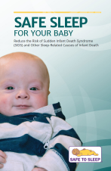
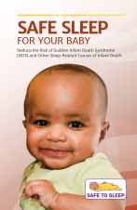
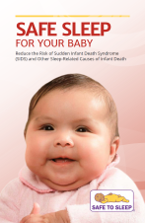
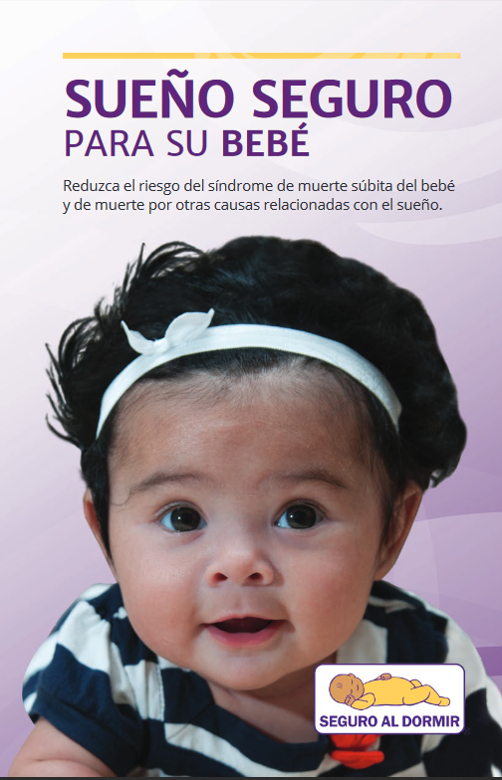
Safe to Sleep Campaign Materials
nichd.nih.gov
Notes:
NICHD back to Sleep materials became available in the 1990’s. They were updated in 2017 to the Safe to Sleep materials with the new AAP recommendations.
http://www.nichd.nih.gov/sts/Pages/default.aspx

Slide 32
Safe to Sleep Campaign Materials
nichd.nih.gov
Notes:
These are 8 ½ by 11-inch posters. They too have been revised to reflect the 2016 AAP updated Recommendations.
These tear-off sheets are great to use in the hospital, child care and clinic settings.
Go to http://www.nichd.nih.gov/sts/Pages/default.aspx for updated materials.

Slide 33
Safe to Sleep Materials Video
Safesleepkansas.org
Notes:
Safe sleep video was written and created by Safe KIDS Kansas in partnership with Lawrence Memorial Hospital, Child Care Aware, KU, Parents as Teachers and the KIDS Network. This video was produced in 2010 and reflects the recommendations at that time. The AAP has revised recommendations that are not included in this video.

Slide 34
SIDS in Child Care Rachel Y. Moon, MD, Children’s National Medical Center, Washington, D.C.
Approximately 20% of SIDS deaths occurred while the infant was in the care of a nonparent caregiver.
60% in family child care
20% in child care centers
Approximately ¹/₃ of SIDS-related deaths in child care occur in the first week, ¹/₂ of these on the first day.
Notes:
Research shows that when SIDS happens in child care it frequently happens very early on. There is question as to if it is related to the change in environment and sleep position. Thus, stressing the need to have the conversation with your childcare provide about correct safe sleep practices.
On February 3, 2012, KDHE Child Care Regulations were updated to reflect the following legislation;
K.A.R. 28-4-114a. Initial and ongoing professional development.
at least two clock-hours of training on safe sleep practices and sudden infant death syndrome if the individual will be caring for children under 12 months of age.
K.A.R. 28-4-115a. Supervision.
Each child who is napping or sleeping shall be within sight or hearing distance of the provider and shall be visually checked on by the provider at least once every 15 minutes.

Slide 35
Safe Sleep in Child Care Create a Safe Sleep Policy
Benefits of a safe sleep policy
Shows parents baby’s health and safety is a top priority
Educates staff
Promotes consistent care
Educates parents
Empowers the child care provider
Reduces the risk of liability
See policy example at www.kidsks.org
Notes:
Some child care providers might be reluctant to tell parents what to do and find it easier to give in to the parents’ preference. It may be a good idea to designate a couple of people in the child care facility or home to be the point people on safe-to-sleep issues. When there is a parent that is concerned about the policy or is uninformed, these point people can be responsible for speaking with them. Know that what you share with the parent might be the piece of information they have been missing in the care they provide their child. Although they may have heard the information before you might just be the person who gets through to them.
Why would a child care provider be reluctant to discuss the situation with the parents of a child in your care?
Allow time for group to answer with their concerns.

Slide 36
Safe Sleep for the
Child Care Provider Course
Online at: ks.train.org
English Course #1073036
Spanish Course #1076446
Notes:
This presentation is available online at Kansas Train. Go to ks.train.org and use the course ID’s to locate the training.
The trainings takes about 1.5-2 hours. The training includes a pretest and post-test and will provide a
certificate of attendance at the conclusion.

Slide 37
Licensing Requirements
National Resource Center for Health and Safety in Child Care and Early Education (NRC)
nrckids.org
800/598-KIDS (5437)
Caring for Our Children: National Health and Safety Performance Standards: Guidelines for Out-of-Home Child Care Programs, Third Edition (2011)
Individual state licensing information
Notes:
This slide provides contact information for the National Resource Center for Health and Safety in Child Care and Early Education. Reducing the Risk of Sudden Infant Death Syndrome: Applicable Standards From Caring for Our Children: National Health and Safety Performance Standards: Guidelines for Out-of-Home Child Care is readily accessible and easy to use.
On this Web site, there is also information about the licensing regulations for each state. You can check the details of your state’s regulations.

Slide 38
Healthy Child Care America Safe Sleep Campaign
American Academy of Pediatrics
http://www.healthychildcare.org/sids.html
Notes:
This is the contact information for the AAP Early Education and Child Care Initiatives. You can find specific information regarding safe sleep and child care.

Slide 39
Post-Test

Slide 40
Referring to the KIDS Network
Let the family know you will contact the KIDS Network to provide support
Call or fax provisional information
Kansas Infant Death and SIDS Network, Inc.
300 W. Douglas Ave. Suite145
Wichita, KS 67202
Phone: 316-682-1301
Fax: 316-682-1274
www.kidsks.org
Notes:
Go to Kidsks.org for more information or to refer a bereaved family.

Slide 41
Bibliography
Ahlers-Schmidt CR, Schunn C, Engel M, Dowling J, Neufeld K, Kuhlmann S. Implementation of a Statewide Program to Promote Safe Sleep, Breastfeeding and Tobacco Cessation to High Risk Pregnant Women. Journal of Community Health. 2018.
Ahlers-Schmidt CR, Schunn C, Sage C, Engel M, Benton M. Safe Sleep Practices of Kansas Birthing Hospitals. Kansas Journal of Medicine. 2018; 11(1): 1-4.
Ahlers-Schmidt CR, Brown M, Engel M, Schunn C. Rosell J, Neil T, Kuhlmann Z. Baby Talk: Pilot testing a community collaborative prenatal education program to support low income women. J Ped Moth Care. 2017; 2(2):113.
Ahlers-Schmidt CR, Schunn C, Redmond ML, Smith S, Brown M, Kuhlmann S, Engel M, Benton M. Qualitative Assessment of Pregnant Women’s Perceptions of Infant Sleep Boxes. Global Pediatric Health. 2017; 4: 1-7.
Ahlers-Schmidt CR, Schunn C, Kuhlmann S, Kuhlmann Z, Engel M. Developing a state-wide infrastructure for safe sleep promotion. Sleep Health. 2017; 3(4):296-299.
Ahlers-Schmidt CR, Schunn C, Nguyen M, Nimeskern J, Ilihe R, Kuhlmann S. Does providing infant caregivers with a wearable blanket increase safe sleep practices? A randomized controlled trial. Clinical Pediatrics. 2016; Vol. 55(1) 79–82.
Ahlers-Schmidt CR, Kuhlmann S, Kuhlmann Z, Schunn C, Rosell J. To Improve Safe-Sleep Practices, More Emphasis Should Be Placed on Removing Unsafe Items From the Crib. CLIN PEDIATR. 2014; 0009922813518964.
Ahlers-Schmidt CR, Schunn C, Dempsy M, Blackmon S.. Evaluation of Community Baby Showers to Promote Safe Sleep. Kansas Journal of Medicine. 2014; 7(1):1-5.
American Academy of Pediatrics: Task Force on Infant Positioning and SIDS. Pediatrics. 1996; Vol. 98, No. 6.
Bureau of Epidemiology and Public Health Informatics, KDHE Annual Summary of Vital Statistics for 2020.
Colson ER, Rybin D, Smith LA, Colton T, Lister G, Corwin MJ. Trends and factors associated with infant sleeping position: the national infant sleep position study,
1993-1997. Arch Pediatr Adolesc Med. 2009; 163:1122-1128.
Notes:
This presentation is based on the 2016 AAP Safe Sleep Recommendations.

Slide 42
Bibliography
Colvin JD, Collie-Akers V, Schunn C, Moon, RY. Sleep Environment Risks for Younger and Older Infants. Pediatrics. 2014;134:e406-e412.
Guntheroth, W. The Triple Risk Hypotheses in Sudden Infant Death Syndrome. Pediatrics. 2002; Vol. 110, No. 5, pp. E64.
Kansas State Child Deth Reivew Board Annual Report, Office of the Kansas Attorney General, Derek Schmidt, 2019.
Kuhlmann Z, Kuhlmann S, Schunn C, Klug B, Greaves T, Foster M, Ahlers-Schmidt CR. Collaborating with obstetrical providers to promote infant safe sleep guidelines. Sleep Health 2016;2:219–224.
Mason B, Ahlers-Schmidt CR, Schunn C. Improving Safe Sleep Environments for Well Newborns in the Hospital Setting. CLIN PEDIATR. 2013; 0009922813495954.
McDonnell, e., Moon, R.Y. Infant Deaths and injuries associated with wearable blankets, swaddle wraps, and swaddling. Journal of Pediatrics. 2014; electronic before print.
Moon, R., Patel, M. and McDermott Shaefer, S. Sudden Infant Death Syndrome in Child Care Settings. Pediatrics,. 2000; Vol. 106, No. 2, pp. 295-300.
Task Force on Sudden Infant Death Syndrome. SIDS and Other Sleep-Related Infant Deaths: Updated 2016 Recommendations for a Safe Infant Sleeping Environment. Pediatrics Oct 2016, e20162938; DOI: 10.1542/peds.2016-2938
Task Force on Sudden Infant Death Syndrome. SIDS and Other Sleep-Related Infant Deaths: Expansion of Recommendations for a Safe Infant Sleep Environment. Pediatrics. 2011
Von Kohorn I, Corwin MJ, Rybin DV, et al. Influence of prior advice and beliefs of mothers on infant sleep position.
Arch Pediatr Adolesc Med. 2010;164:363-369.
Willinger, M. , James LS, Catz C. Defining the sudden infant death syndrome (SIDS): deliberations of an expert panel convened by the National Institute of Child Health and Human Development. Pediatr Pathol. 1991; Sep-Oct;11(5):677-84.
Wulbrand H, McNamara F, Thach B. The Role of Arousal Related Brainstem Reflexes in Causing Recovery From Upper Airway Occlusion in Infants. Sleep. 2008; Vol. 8;, No. 31, pp. 833-840.
Notes:
And finally, this presentation was developed and copyrighted by the Kansas Infant Death and SIDS Network. Go to KIDSKS.org for more information. If you have any questions about the material provided, please contact Christy Schunn at the KIDS Network. Thank you for listening and thank you for the work you do to keep infant safe.

